Slide 1



Hemodynamic Response Function

Slide 2
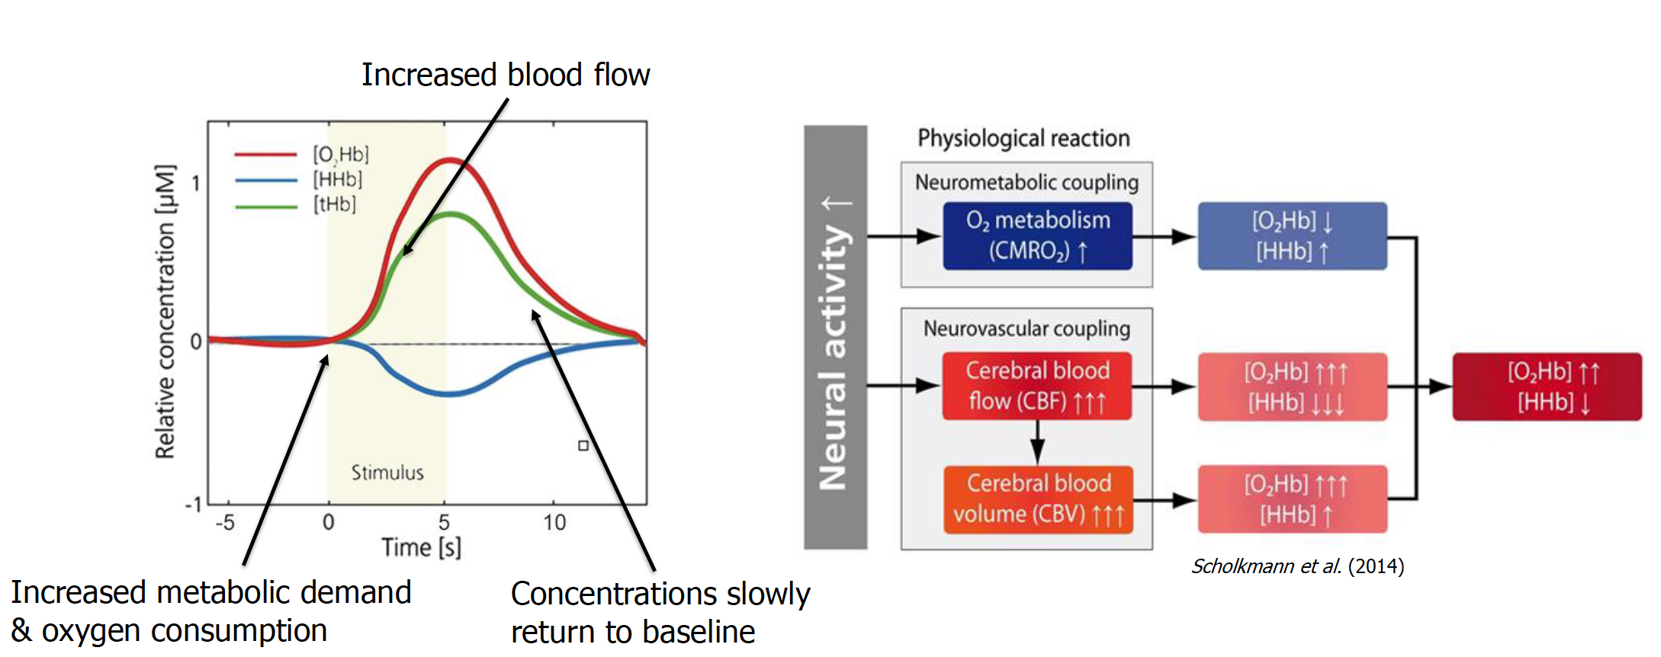
fNIRS: The Hemodynamic Response

Slide 3
Why Gamma Function
Shape Matching: The mathematical curve of a Gamma distribution naturally mimics the real-world rise, peak, and fall of blood oxygenation in active brain regions.
Computational Efficiency: It offers a simple, smooth approximation requiring very few parameters, making it a standard choice for functional Magnetic Resonance Imaging (fMRI) analysis.

Slide 4
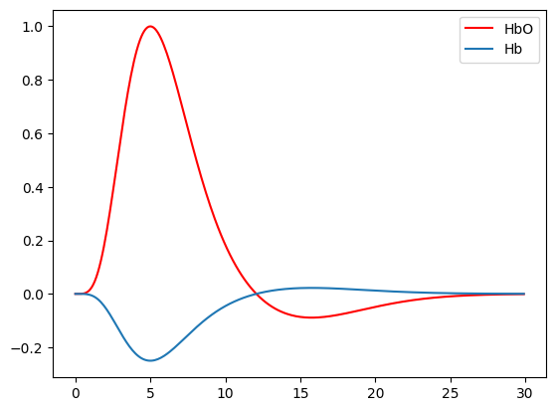
Key components
The Delay (Lag): Captures the 4 to 6-second delay between the neural trigger and the peak oxygen delivery.
The Peak: Represents the maximum oxygenated hemoglobin concentration in response to a stimulus.
The Undershoot: Often modeled by combining a second, delayed Gamma function to capture the temporary dip below baseline during recovery.
Hb = -0.25HbO

Slide 5
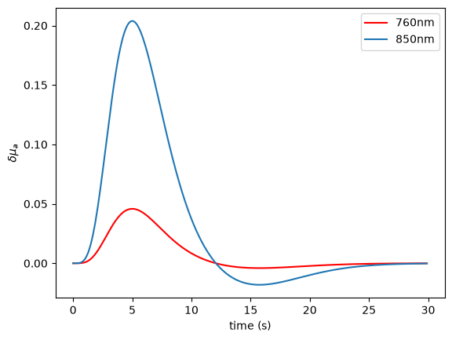
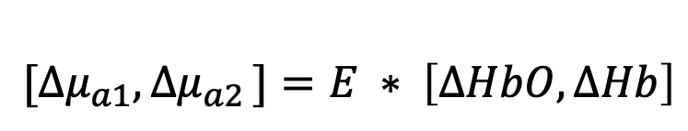
HRF to optical properties
Using Extinction Coefficients of HbO and Hb, we can convert HRF to changes in Absorption: https://omlc.org/spectra/hemoglobin/
$${[∆μ}_{a1}{, ∆μ}_{a2}]=E ∗ \left[∆HbO,∆Hb\right]$$

Slide 6
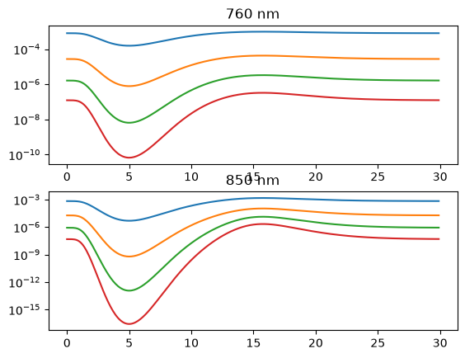
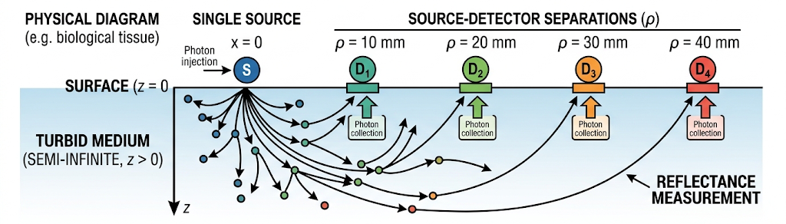
Semi-infinite model
Model a single source and 4 detectors
Add changes of absorption to a baseline model
Generate measurements

Slide 7
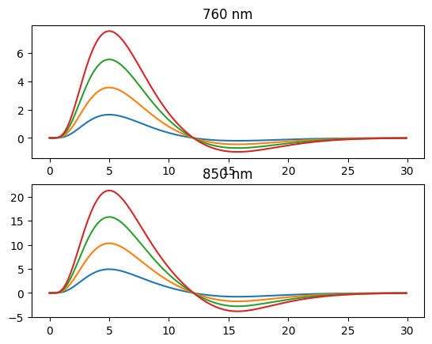
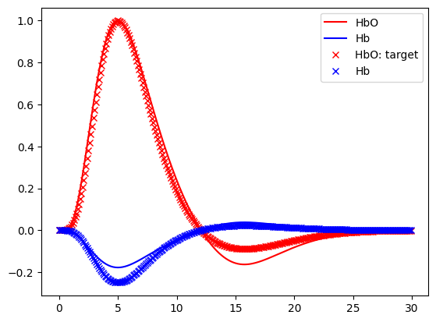
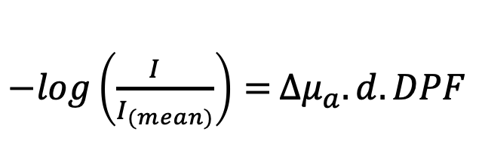
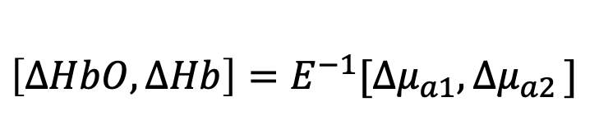
Use modified Beer-Lambert to recover HRF
- Log(mean) data
$−log\left(\frac{I_{}}{I_{(mean)}}\right)=$ ${∆μ}_{a}.d.DPF$
$$\left[∆HbO,∆Hb\right]=E^{−1}{[∆μ}_{a1}{, ∆μ}_{a2}]$$

Slide 8
Questions?

